Slide 1
The Fusion of Chatbots and Augmented Reality Unmatched E-Commerce Experiences
Sitara Khurram,
sitarah3126@gmail.com

Slide 2
Introduction
Online shopping has completely changed the way we buy things, making it super convenient for people all around the world. But, like any big change, it comes with its own set of problems. Shoppers often struggle with not being able to try on products before buying and feeling overwhelmed by too many choices. These issues can make the whole online shopping experience less enjoyable and sometimes even frustrating.
The good news is that there's a solution on the horizon. As technology gets better, we have the chance to be creative and tackle these problems. That's where the combination of Chatbots and Augmented Reality comes in. By blending these two technologies, we aim to make online shopping even better and more enjoyable. This presentation dives into how this fusion can transform the virtual shopping experience, offering users something truly special in the world of e-commerce.

Slide 3
Objectives of the Research
Overcoming Lack of Try-Ons: The AR feature allows users to virtually try on clothes, solving the challenge of not being able to physically try them on before purchase.
Dynamic Chatbot Assistance: The chatbot's real-time responses address user queries, provide detailed information, and offer size recommendations, overcoming the limitations of existing solutions.
Transparent Decision-Making: Users can make well-informed decisions with the combination of real-time try-ons, comprehensive chatbot assistance, and the integration of dynamic price comparison functionalities.
Real-Time Apparel Try-ons:
We aim to create a system where you can virtually try on clothes in real-time. No more guessing how they'll look – you can see it instantly
Chatbot Assistance:
Imagine a friendly chatbot helping you out during your shopping adventure. It can answer your questions, suggest sizes, and even give you the latest info about products.
Price Comparison:
Ever wondered if you're getting the best deal? Our research focuses on integrating a feature that allows you to compare prices across different online stores in real-time, ensuring you make informed and budget-friendly choices.

Slide 4
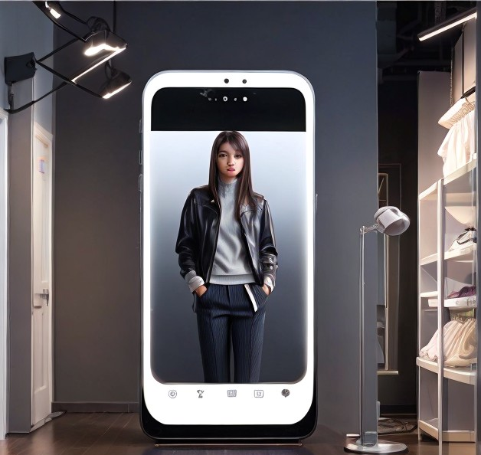

Online Shopping Challenges
Overwhelming Choices:
Lack of Physical Try-Ons:
Without the ability to try on clothes or products, shoppers can feel uncertain about how things will actually look or fit.
The vast array of options can be confusing and sometimes stressful. Choosing the right product from numerous alternatives can be a real challenge.

Slide 5
Existing Solutions
Virtual Try-On Systems: Some systems use deep learning to create visually appealing virtual try-ons, giving users a better idea of how products will look on them.
Smart Dressing Mirrors: Innovations like smart mirrors digitize clothes using machine learning and computer vision. These mirrors recommend fashionable combinations, making outfit choices easier.
Marker-less Augmented Reality for E-Commerce: This solution not only improves virtual try-on experiences but also tackles decision-making challenges, offering customized and interactive solutions.
3D-Reconstructed Apparel with Virtual Reality: To overcome the limitations of 2D views in online shopping, augmented reality steps in. It allows users to visualize products in their physical space before making a purchase, simplifying decision-making.
1
Go to Insert > 3D Models from a File…
This will open the Insert 3D Model Window where you can search your computer, network or cloud drive for any saved 3D models.
2
Insert the 3D model by selecting the file and clicking on Insert.
The 3D Model will now be placed onto your PowerPoint slide

Slide 6

Existing Solutions - Why They're Insufficient
1
Limited Focus on Real-Time Price Comparisons: Many current solutions lack a dedicated focus on providing dynamic and real-time price comparisons across various e-commerce platforms, a critical feature for informed decision-making.
Inadequate Size Recommendations: The existing systems may not sufficiently address the need for personalized size recommendations, leaving users with uncertainties about whether a selected size will fit them accurately.
Minimal Chatbot Assistance: Some solutions lack the robust chatbot integration needed for comprehensive user support. A well-designed chatbot can provide instant answers, offer detailed product information, and enhance the overall shopping experience.
2

Slide 7



Proposed Solution
The proposed solution brings together Chatbots and Augmented Reality (AR) for an immersive online shopping experience:
1
Chatbot Integration We're incorporating a smart chatbot into the online shopping journey. This chatbot is equipped with natural language processing (NLP) capabilities, ensuring it can comprehensively address user inquiries.
2
Augmented Reality for Real-Time Try-Ons:
3
Real Time Price Comparision

Slide 8
Technical Details - Chatbot Integration
How the Chatbot Elevates Your Experience:
Motion Sensors Initiate Interaction: As you approach, motion sensors detect your presence, triggering the chatbot's activation. It's ready to assist you.
User-Friendly Introduction: The chatbot introduces itself in a friendly manner, presenting a range of assistance options, including virtual try-ons, product inquiries, and style recommendations.
Virtual Try-On Guidance: For virtual try-ons, the chatbot provides step-by-step guidance, utilizing advanced algorithms for diverse styles, tailored suggestions, and real-time feedback on your virtual appearance.
Product Inquiries and Recommendations: Ask the chatbot specific details or seek personalized recommendations. Leveraging natural language processing (NLP), it comprehends queries and delivers accurate information promptly. Machine learning models continuously refine its ability to understand and respond effectively.
Decision-Making Support: Throughout the interaction, the chatbot employs advanced algorithms for decision-making support, enhancing your understanding of available products and facilitating informed choices.
1
2
3

Slide 9
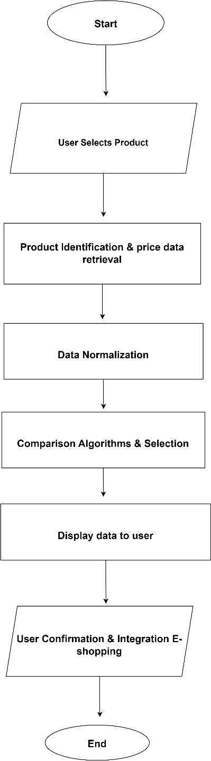
Technical Details - Real-Time Price Comparison
How the Chatbot Elevates Your Experience:
1
E-Commerce Platforms Integration Module: Establishes vital API connections.
Product Identification and Price Data Retrieval: Uses web scraping and machine learning.
Data Normalization: Maintains consistency and coherence.
Comparison Algorithm & Selection: Applies statistical models and machine learning.
Display Results to User: Presents outcomes on the smart mirror interface.
2
3

Slide 10
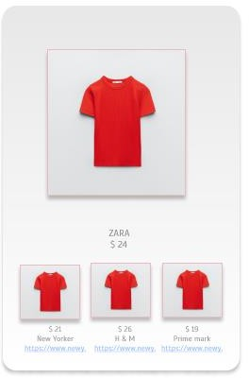
Real-Time Price Comparison - Module
Display Results to User: Utilizes a user-friendly interface on the smart mirror to present price comparison outcomes, showcasing matched products, their corresponding prices, and links to original listings on respective e-commerce sites.

Slide 11
Hardware Specifications
Smart Mirror Essentials:
Display: A LCD display provides an optimal balance of usability and aesthetics, ensuring a visually pleasing and immersive experience.
Interactive Touch Surface: Engage seamlessly with touch sensors, e.
Camera System: Equipped with a high-resolution camera and a wide-angle lens, enhancing virtual try-on experiences and augmenting chatbot functionalities.
Processing Power: Driven by a robust quad-core processor, the smart mirror handles real-time image processing, machine learning tasks, and supports advanced chatbot functionalities.
Connectivity and Accessibility:
Wi-Fi Connectivity: Establishes a seamless connection to e-commerce platforms for real-time price comparison
Power Supply: Operates on standard electrical power,.
User-Centric Design:
Dimensions: With dimensions of 40 inches by 24 inches, the smart mirror is designed to strike the perfect balance between usability and aesthetics,
Input Devices: Touch sensors and a microphone
1
2

Slide 12
Hardware Specifications
User Interaction:
Approach the smart mirror; motion sensors initiate engagement.
Navigate the interface effortlessly through touch gestures or voice commands.
Enhanced Shopping Experience:
Opt for "Virtual Try-On" for real-time outfit visualization.
Engage in dynamic conversations with the chatbot.
Select an outfit to trigger real-time price comparison.
Seamlessly transition to e-shopping through the mirror.
Post-Purchase Support:
Receive size recommendations and personalized post-purchase assistance.
Initiate a secure checkout process, review selections, and place orders.
Access delivery information and track order statuses.
1
2

Slide 13
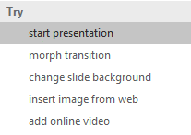


More questions about PowerPoint?
Select the Tell Me button and type what you want to know.
Visit the PowerPoint team blog
Go to free PowerPoint training
SELECT THE ARROW WHEN IN SLIDE SHOW MODE

